Slide 1


Fostering a diverse & welcoming community
Jan-Christoph Borchardt @jancborchardt

Slide 2
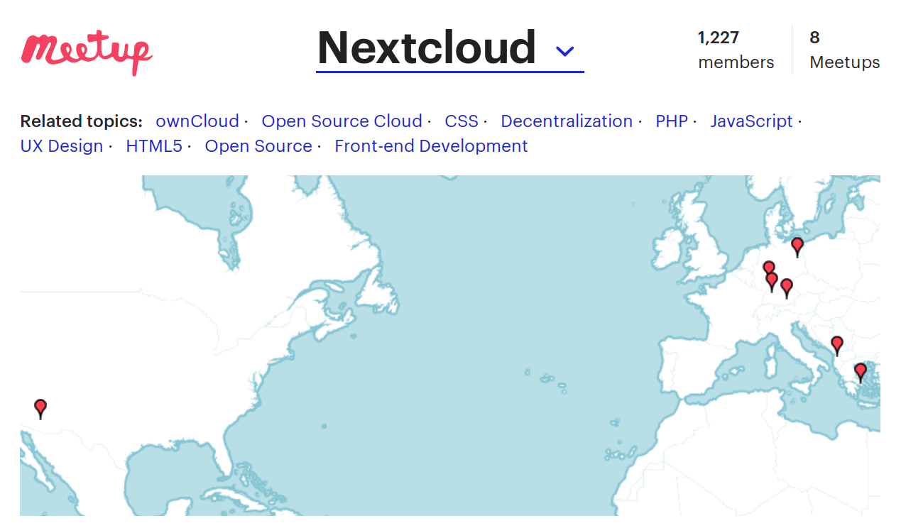

Slide 3
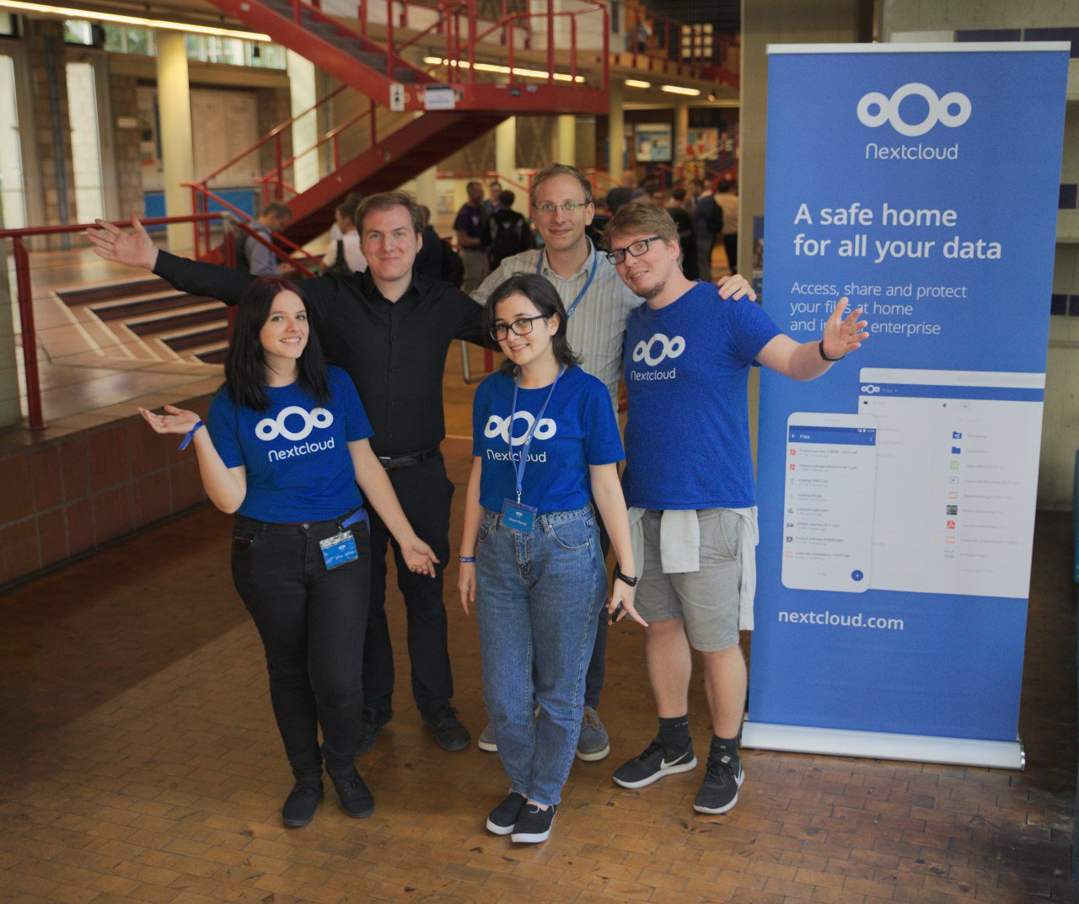


Slide 4
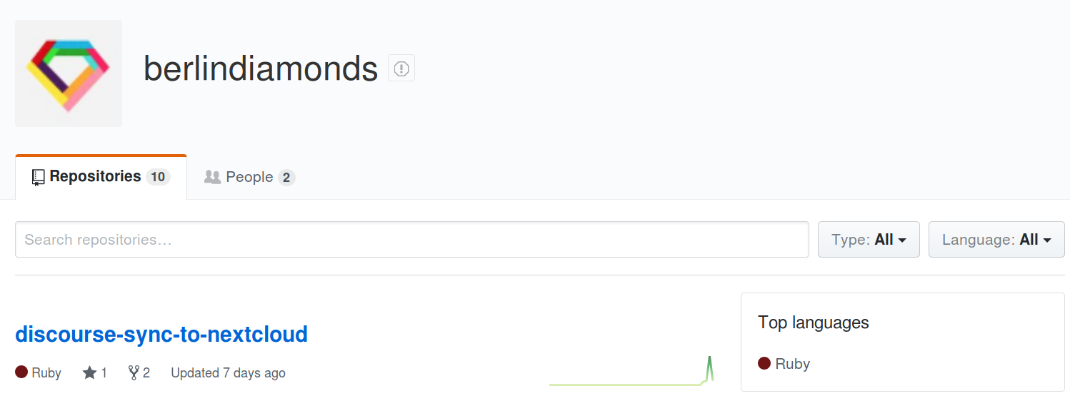

Slide 5

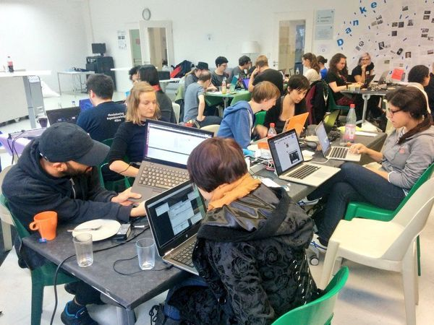

Slide 6
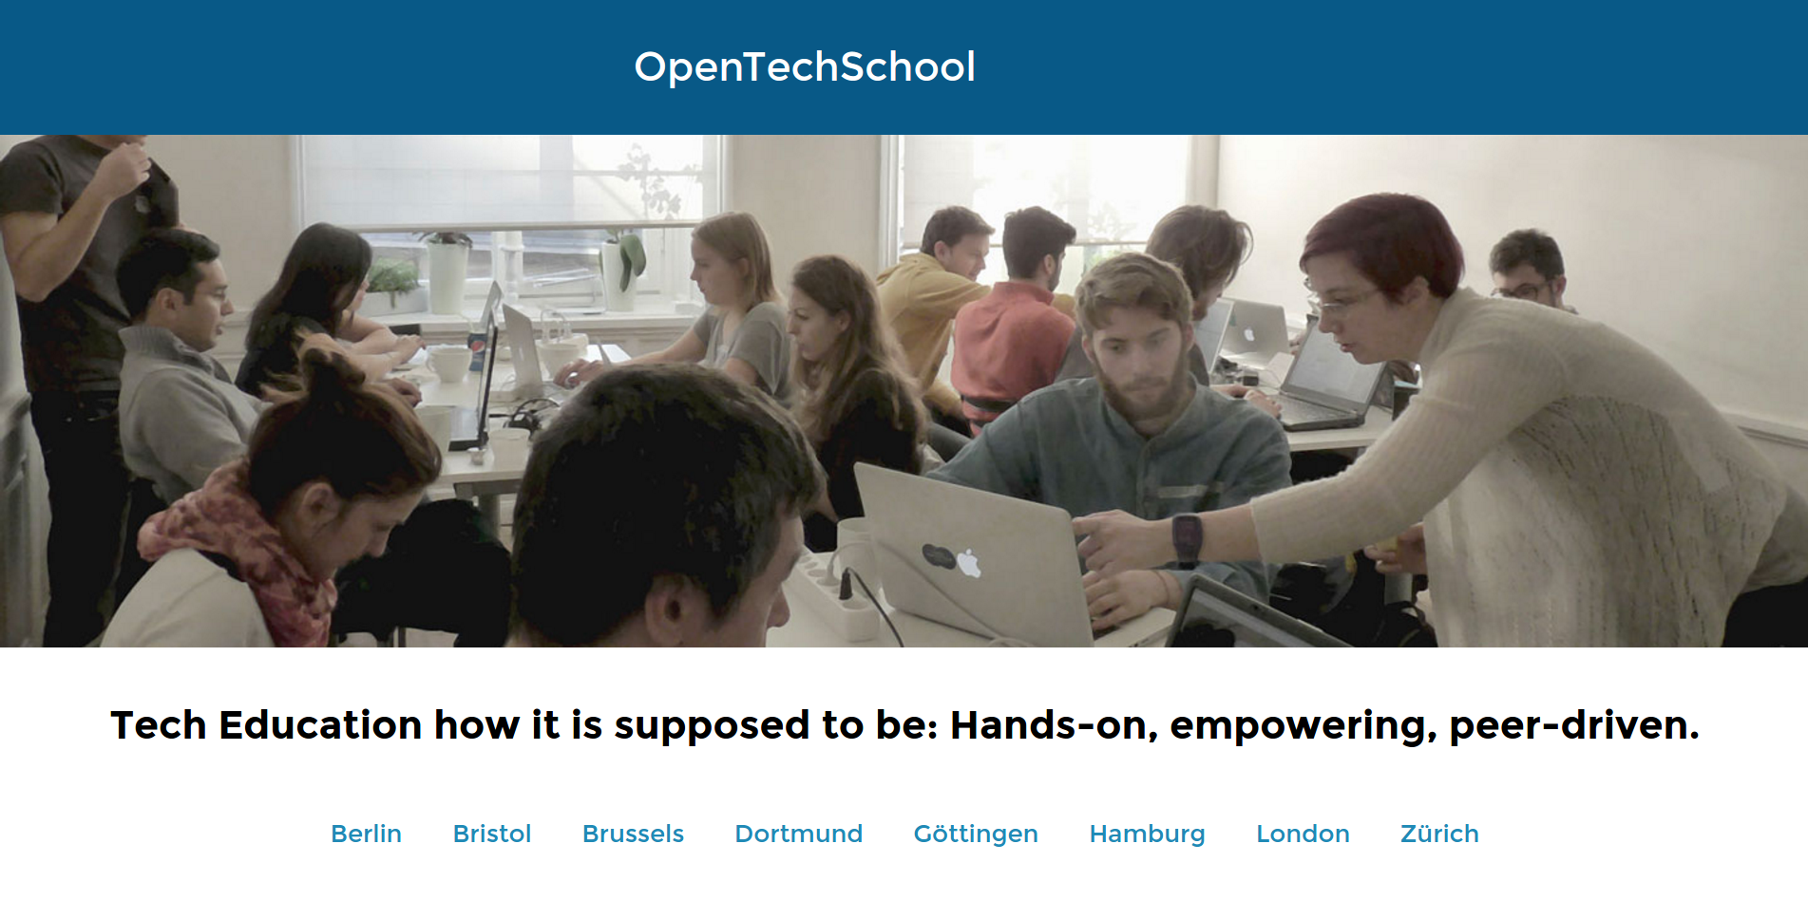

Slide 7


starter issue

Slide 8
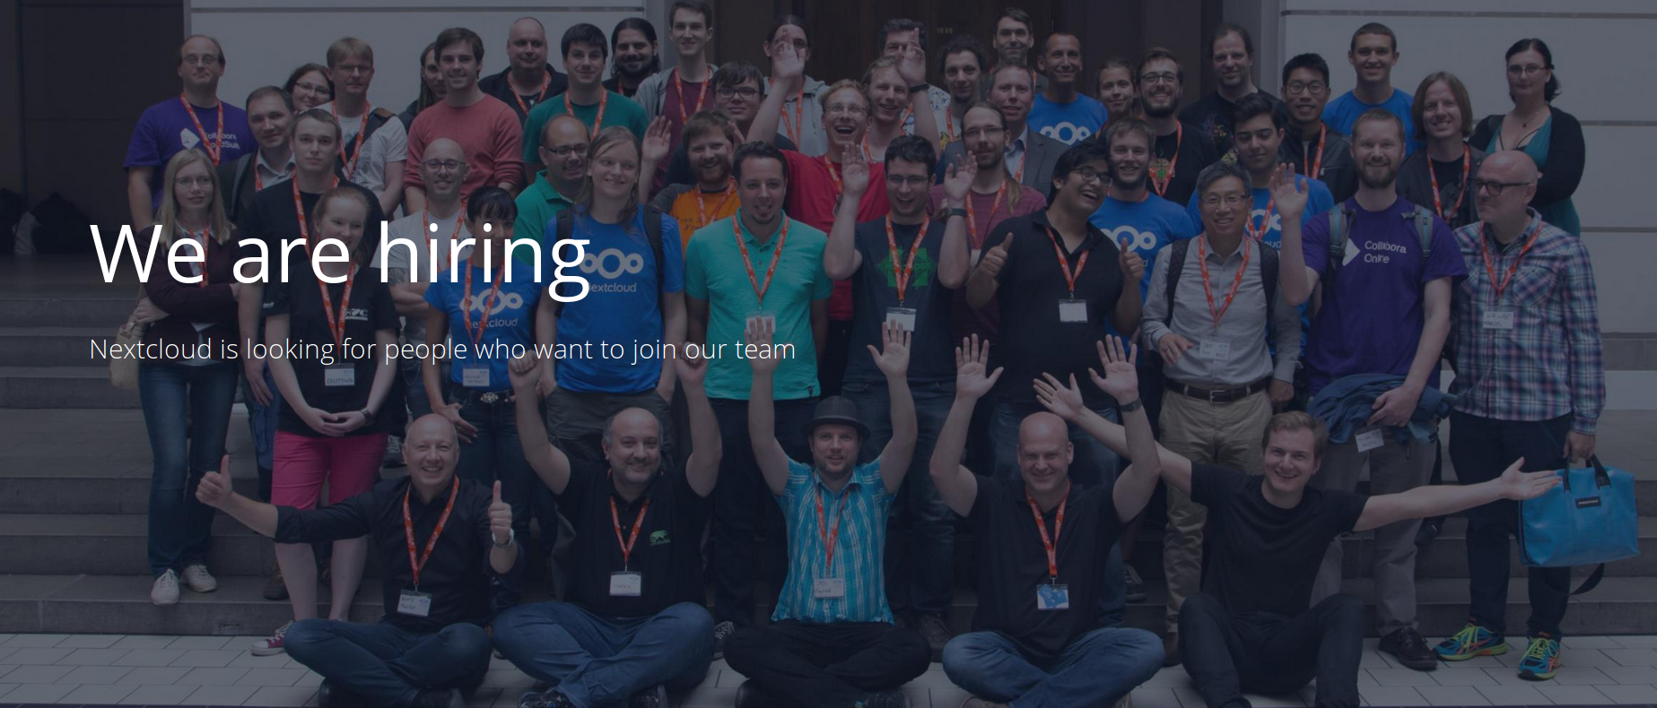
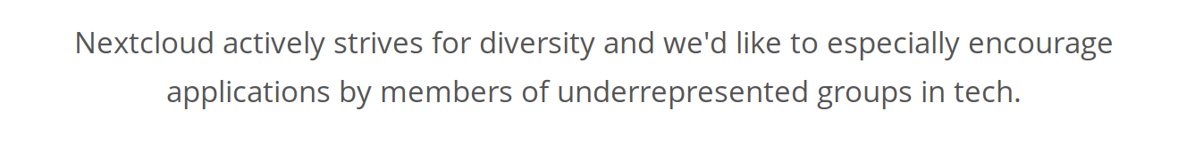

Slide 9


Slide 10
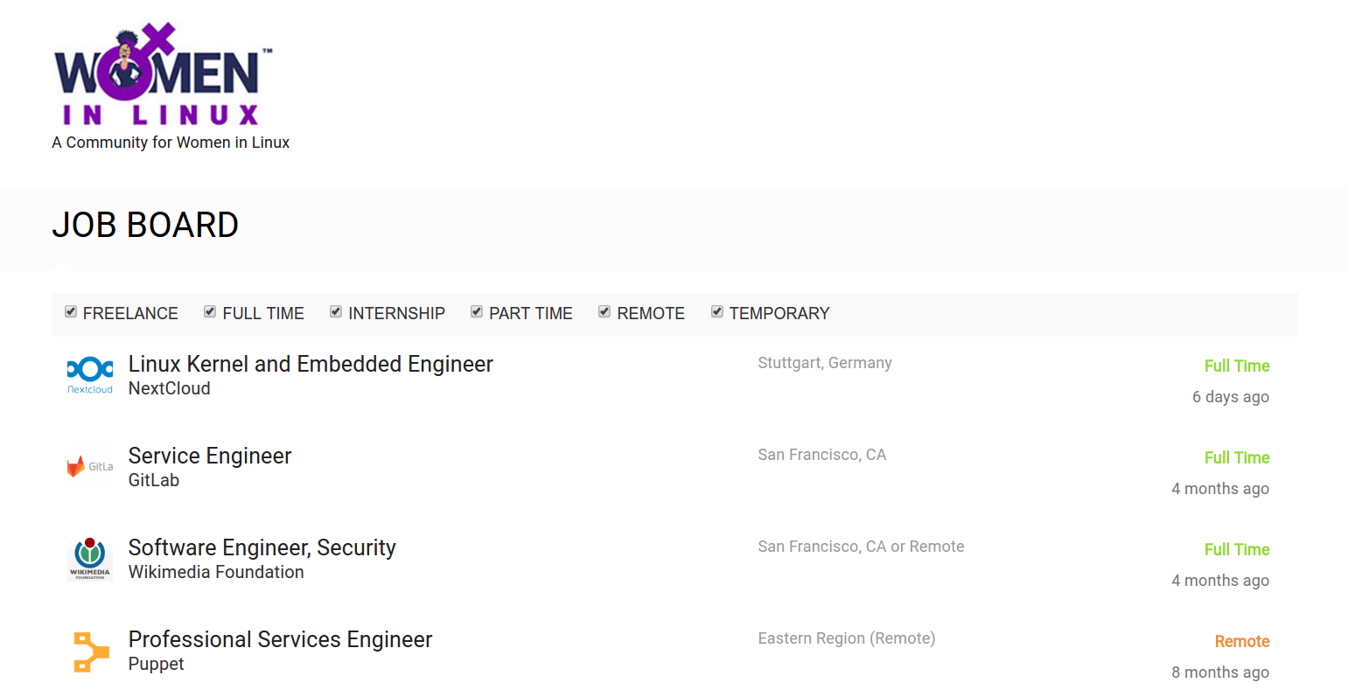

Slide 11
How we can improve

Slide 13
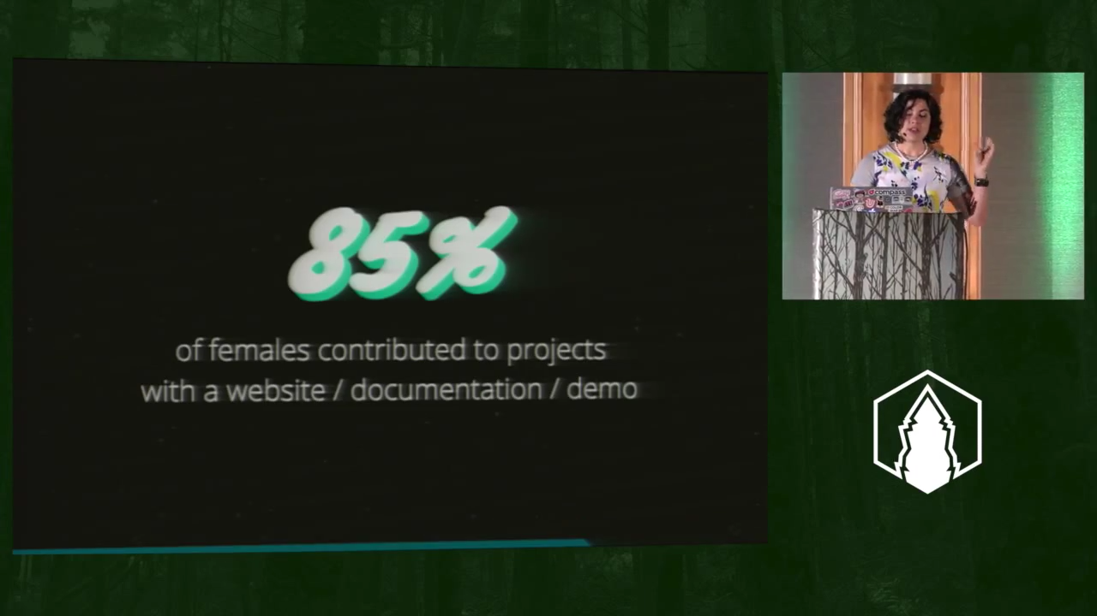

Slide 14
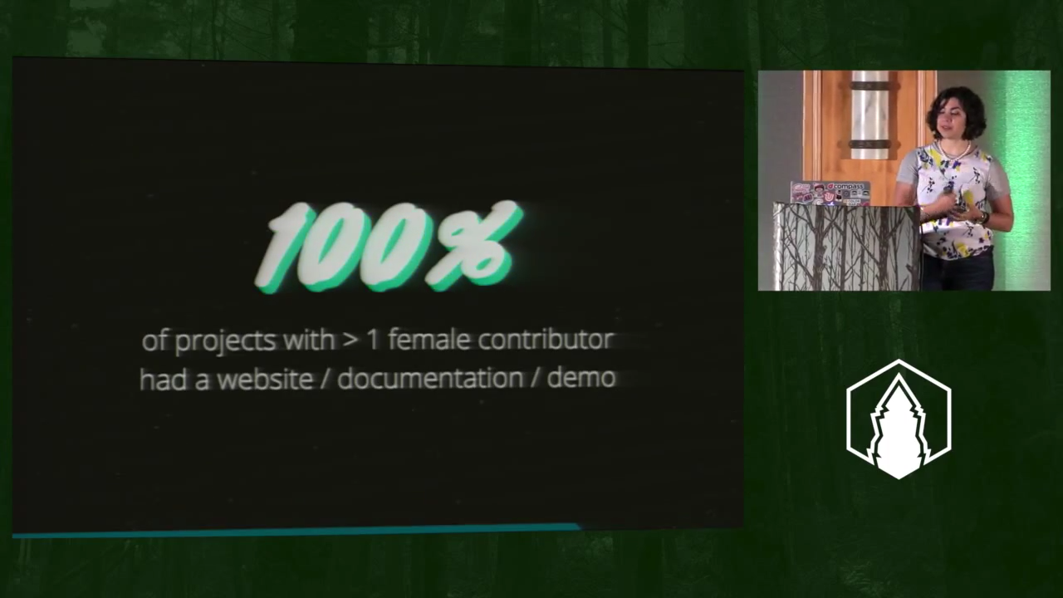

Slide 15
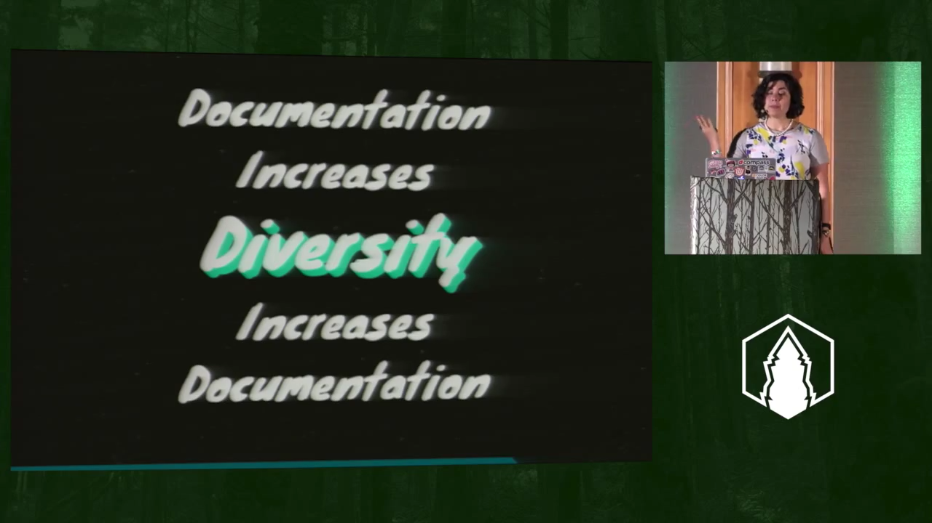

Slide 16
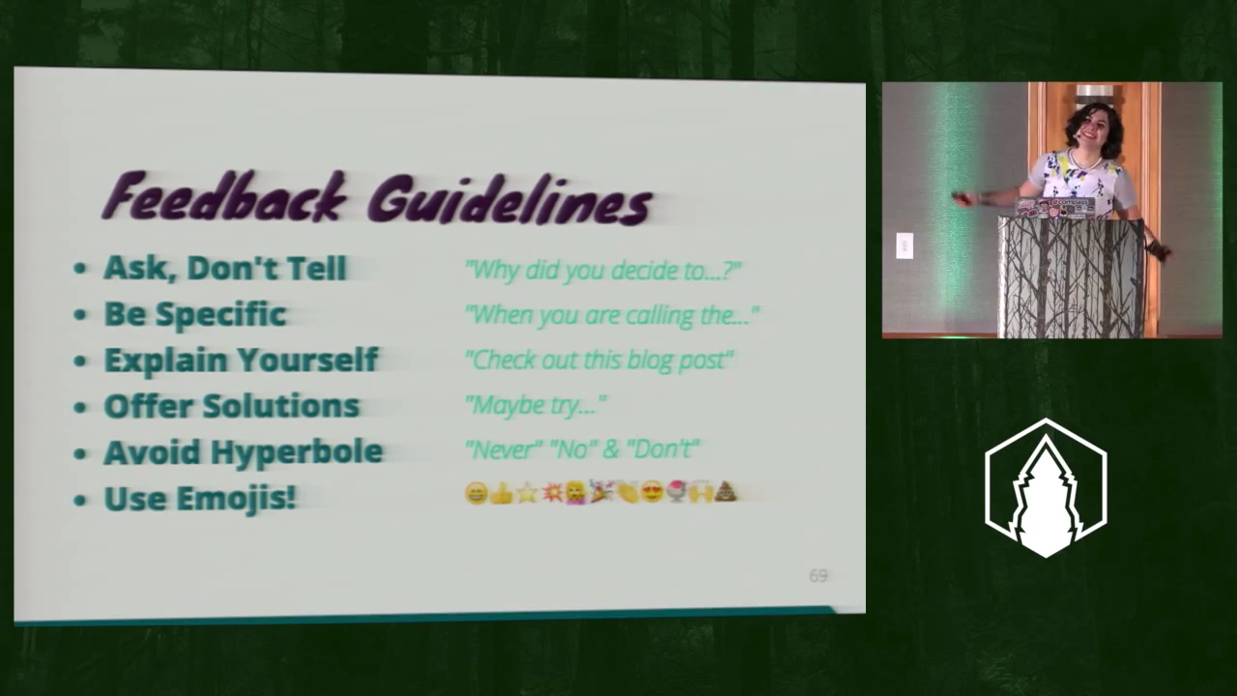

Slide 17

diversitytickets.org

Slide 18

speakerinnen.org

Slide 19


Slide 20
Hi new contributors!
:)
Jan-Christoph Borchardt @jancborchardt

